Slide 1
Aromatic Mountain Technologies (AMT)
Team Members
Antonio Pierre
Matthew Rho
Tom Weikel
Have a team name: Team Power: PoweR Rangers Coffee System
Slogan: “Power Brewed to Power Through”
Aromatic Mountain Technologies (AMT) is an online coffee store that allows customers and employees to buy coffee beans, ground coffee, syrups, coffee accessory and apparel. AMT makes use of an external free API possibly to do payment processing and/or shopping cart API. AMT has internal RESTful APIs that are consumed by the client web pages.
Thought process
Client server / login / endpoints / roles
Online Store (Like Amazon)
Customers
Admin
Employee (access to some but not all Admin areas)
Product pages (One related products, like a Starbucks Coffee and related items)
Payment process (store payment info [credit cards, paypal, electronic transfer])

Slide 2
Aromatic Mountain Technologies (AMT)
User Stories
View Catalog
Add to shopping cart
Checkout (login)
Admin user stories (controls publishing catalog)
As an Admin controls publishing of Employee catalog items and pages
Employee (in employee role and as customers) user stories
As an employee I can create catalog items / pages
As an employee I provide customer support (contact us support, online chat)
As an employee buying from the catalog I want to use my company discount benefits
Customer
As a Customer I want to view the online catalog
As a Customer I want to buy from the online catalog
As a Customer I want to create and use a secure account to make my purchases

Slide 3
Aromatic Mountain Technologies (AMT)
Started with a Javalin version of AMT
Using a deployed database on AWS RDB
Progressed to an IDE AMT-MVC Springframe on Tomcat in the IDE
Installed localhost version of Tomcat all Postman tests passed
This morning issue with localhost version of Tomcat
First it complained about a semi-colon in the CATALINA_HOME variable
Once resolved would not actually bring up the web app
Discovered the issue was using Linux .sh and not Window .bat files
Built EC2 instance installing Tomcat and a working version of AMT-MVC
Encountered cors issue with the EC2 amt-mvc program
@CrossOrigin("http://localhost:4201") still using localhost
Changed to @CrossOrigin(originPatterns = "*", allowCredentials = "true")
Redeployed on EC2.
Did not resolve the issue, tried other patterns
Eventually corrupted Tomcat on EC2

Slide 4
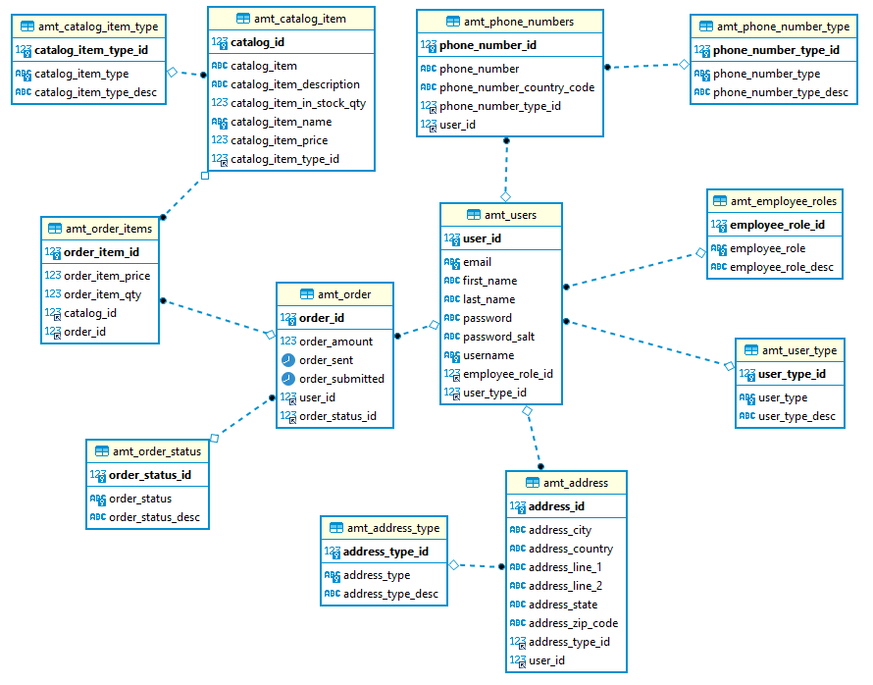
Aromatic Mountain Technologies (AMT) Physical Data Model

Slide 5
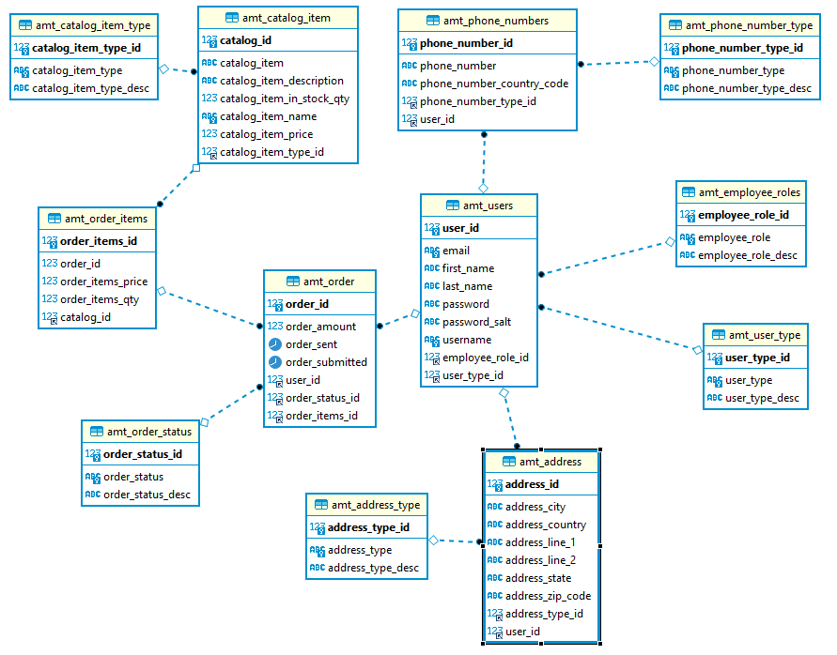
AMT Preliminary Data Model

Slide 6
Aromatic Mountain Technologies (AMT) Basic Requirements
Project 2 will be a group-based, full-stack application that you will be designing and implementing based on user stories of your own choosing.
Backend
The backend should be a RESTful API. However you can use stateful authentication through HttpSessions and not be totally stateless
Look into Json Web Tokens if you really want to achieve stateless authentication
Spring Framework
Instead of utilizing Javalin for the backend, you will be using Spring Framework, which has a web module that allows for controllers to be built and mapped
Use Spring Web MVC to process HTTP Requests/Responses
Hibernate
Logback
Should have a logback.xml configuration file
JUnit tests
You should look into how to generate code coverage reports using SonarCloud
3 person teams
Minimum of 30% overall code coverage
Minimum of 70% service layer code coverage
4 person teams
Minimum of 50% overall code coverage
Minimum of 80% service layer code coverage
Use Mockito as necessary in order to mock the DAO layer, etc.
Selenium Tests (End-to-end (E2E) tests)
For 3 person teams
You should have at least 2 Selenium tests
For 4 person teams
You should have at least 4 Selenium tests
E2E tests don't contribute to code coverage since we are automating actual browser actions and not running tests that are directly interacting with our code like in the case of integration or unit tests

Slide 7
Aromatic Mountain Technologies (AMT) Basic Requirements Continued
Project 2 will be a group-based, full-stack application that you will be designing and implementing based on user stories of your own choosing.
Frontend
You should be using Angular
You must consume your RESTful API backend
You must also consume a second, external REST API
Please make sure the API you want to use is free and working
That way, you do not scramble to revise your project idea when you realize the API either does not work or costs money to use
AWS Deployment (Frontend + Backend)
The frontend and backend should be deployed on your EC2 instance
You can utilize the Tomcat server that you set-up on your EC2 to host your backend Spring Framework application
You can also deploy static files (.html, .js) containing your Angular frontend through Tomcat as well
DevOps Pipeline
This requirement should likely be saved towards the end, when you have already finished the other requirements
You should have a Jenkins pipeline set-up for automated building and deployment of your backend
You can also choose to do the same for your frontend

Slide 8
Aromatic Mountain Technologies (AMT) Basic Requirements Continued
Steps Each Team Should Complete
As a team, you must
Decide a project idea to design and implement
Have a name for your project (very important for your portfolio, be creative with your project name)
Have a team name (be creative with this one as well)
Have a description of the Project (very important for your portfolio)
Professionally worded and phrased
Have several user stories in the format we have described when talking about agile/scrum
A list of the technologies you will be using (should be utilizing all of the technologies we have learned (minus Javalin), but it is best to rearticulate this so that you can really drive in the point)
Please create a document containing all of the above information and have one person from the team email it to me. After that point, there will be time to meet me in a breakout so that I can confirm and give the all clear for your project.
The sooner the above steps are completed, the sooner you can start with the project.
Project Due Date
September 13th, 2021

Slide 9
AMT Project Generic<T> Process Flow Model
DB
com.tlw8253.utility
Hibernate
SessionFactorySingleton
com.tlw8253.model
<T>Model
com.tlw8253.dao
<< interface >>
Data Access Object
GenericDAO<T>
connects
creates
updates
com.tlw8253.model
<Tn>Model
implements
uses
access
returns
com.tlw8253.dto
Data Transfer Object
DTO
AddOrEditDTO
com.tlw8253.dao
<T>DAOImpl
uses
com.tlw8253.exception
BadParameterException
com.tlw8253.dao
<Tn>DAOImpl
com.tlw8253.dto
Data Transfer Object
<T>DTO
<T>AddOrEditDTO
extends
com.tlw8253.exception
DatabaseException
uses
com.tlw8253.dto
Data Transfer Object
<Tn>DTO
<Tn>AddOrEditDTO
throws
uses
com.tlw8253.service
<T>Service
controls
uses
com.tlw8253.exception
RecordNotFoundException
com.tlw8253.service
<Tn>Service
com.tlw8253.controller
<T>Controller
HTTP Request / Response
processes
com.tlw8253.controller
<Tn>Controller
com.tlw8253.exception
AuthenticationFailureException

Slide 10
Aromatic Mountain Technologies (AMT) Summary TBD
Technologies requirements all implemented
Other general requirements met or exceeded
3 layered architecture
Hibernate “create” for creating the schema
Hibernate HQL performing object data loads, record create and updates
Utilize the Controller, Service, DTO, DAO design pattern
MariaDB
Logging accomplished using Logback
Login session control and validation
HTTP Endpoints (Login, Employee and Customer)
Front-end
Login, Employee, Customer, Catalog interactive pages
Other considerations
Implementing GenericDAO<T> model fully realized
Extend Add/Edit DTO storing data generically in HashMaps
JUnit and Mockito test cases
Extensive utilization of internal driver tests
Extensive Logging through package logging levels
Postman utilize for some initial endpoint tests
Internal test drivers and Admin driver

